Slide 1
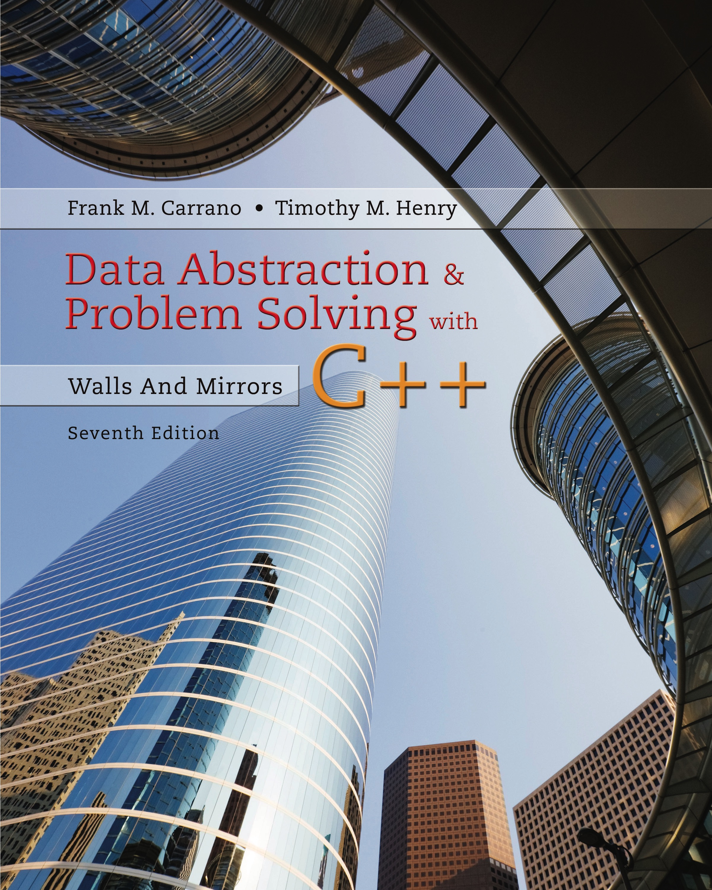
Data Abstraction & Problem Solving with C++: Walls and Mirrors
Seventh Edition
C++ Interlude 6
Overloaded Operators and Friend Access
Copyright © 2017, 2013, 2007 Pearson Education, Inc. All Rights Reserved
Notes:
If this PowerPoint presentation contains mathematical equations, you may need to check that your computer has the following installed:
1) MathType Plugin
2) Math Player (free versions available)
3) NVDA Reader (free versions available)

Slide 2
Overloaded Operators (1 of 3)
An overloaded operator has more than one meaning
In class instances, must define new meaning for operators such as the equality operator ==
For lists they are equal if they have identical lengths and items

Slide 3
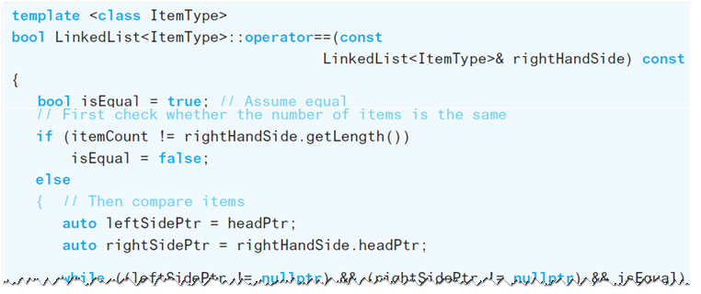
Overloaded Operators (2 of 3)
Linked list implementation of overloading ==

Slide 4
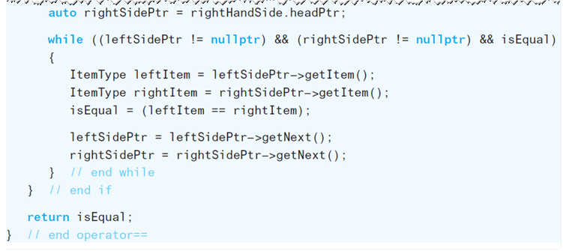
Overloaded Operators (3 of 3)
Linked list implementation of overloading ==

Slide 5
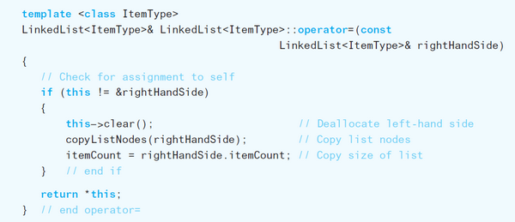
Overloading = for Assignment
Without overloaded assignment operator
End up with shallow copy
Implementation

Slide 6

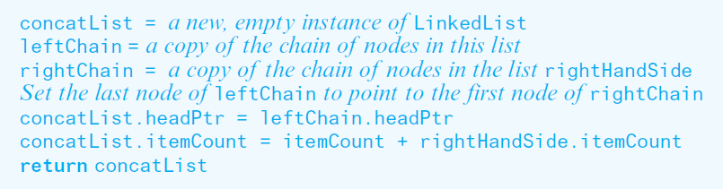
Overloading + for Concatenation
Declaration
Logic

Slide 7
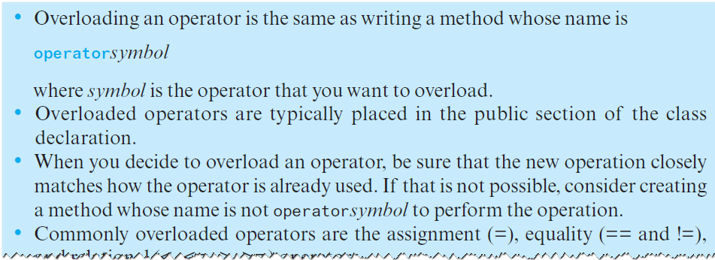
Guidelines for Overloading Operators (1 of 2)

Slide 8
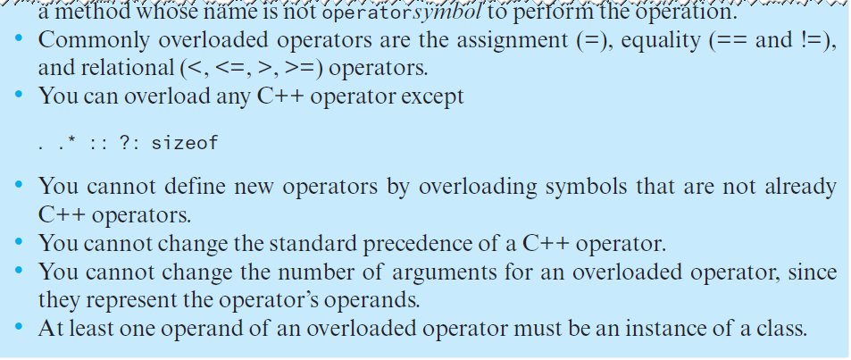
Guidelines for Overloading Operators (2 of 2)

Slide 9
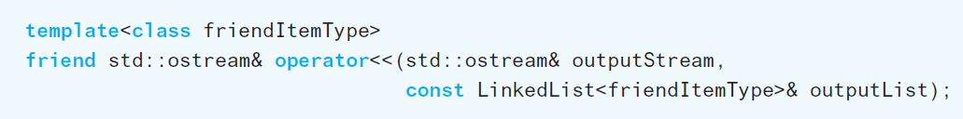
Friend Access and Overloading << (1 of 3)
Functions and classes
Can be friends of a class
We wish to grant operator<< class access to private and protected data of LinkedList

Slide 10
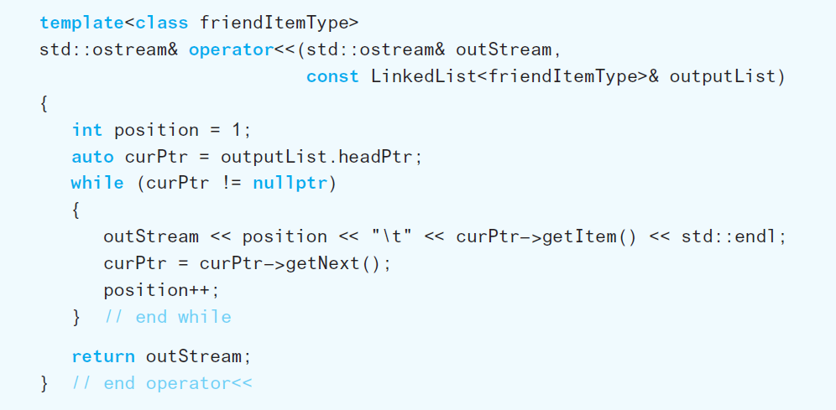
Friend Access and Overloading << (2 of 3)
A friend method

Slide 11
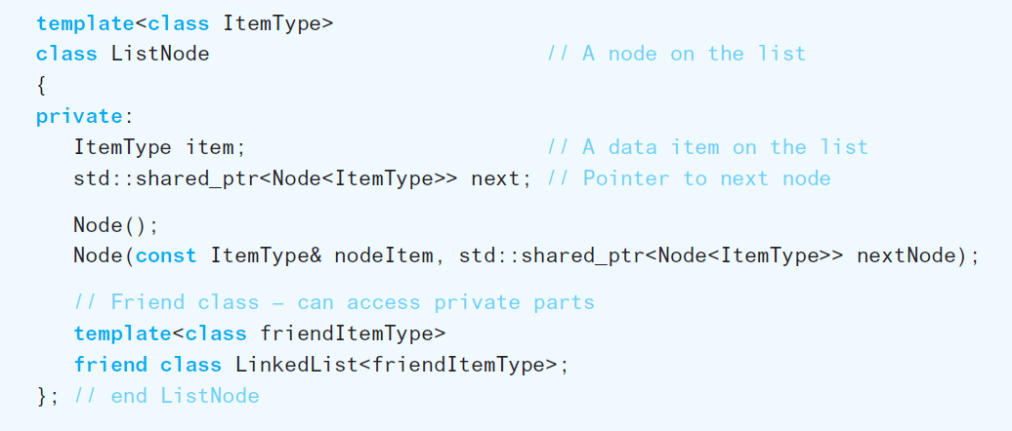
Friend Access and Overloading << (3 of 3)
A friend class

Slide 12

Copyright

